Slide 1
Fox Canyon Groundwater Management Agency
5-Year GSP Evaluation for the LPVB: Numerical Modeling and Projects
Jill Weinberger and Trevor jones
April 2024

Slide 2
Table of Contents
01
5-Year Evaluation Timeline
02
Previous GSP Modeling
03
Modeling for the 5-Year Evaluation
04
Opportunities for Engagement

Slide 3
Stakeholder Involvement
5-Year Evaluation Timeline
May 2024 - January 2025
August 2023
Kickoff Meeting
April 2024
Public Workshop
Public Workshop
(GSP Amendments)
Submittal to
DWR
Modeling Approach Presented
to FCGMA Board
September
2023
October
2023
LPVB PAC and TAC
Consultation
Finalize Modeling
Assess Minimum Thresholds (MTs)
Assess Measurable Objectives (MOs)
Re-evaluate Sustainable Yield
Draft Reports
Plan Area and Background Review
Model Scenario Development
Current Groundwater Conditions
Monitoring Network Review
Actions Taken by FCGMA
GSP Implementation Progress
FCGMA Board Review of 5-Year Evaluations
Public Workshop

Slide 4
Stakeholder Involvement
5-Year Evaluation Timeline
May 2024 - January 2025
August 2023
Kickoff Meeting
April 2024
Public Workshop
Public Workshop
(GSP Amendments)
Submittal to
DWR
Modeling Approach Presented
to FCGMA Board
September
2023
October
2023
LPVB PAC and TAC
Consultation
Finalize Modeling
Assess Minimum Thresholds (MTs)
Assess Measurable Objectives (MOs)
Re-evaluate Sustainable Yield
Draft Reports
Plan Area and Background Review
Model Scenario Development
Current Groundwater Conditions
Monitoring Network Review
Actions Taken by FCGMA
GSP Implementation Progress
FCGMA Board Review of 5-Year Evaluations
Public Workshop

Slide 5
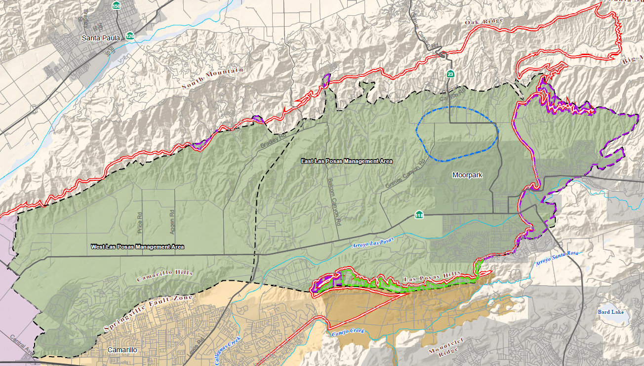
Background Information – Undesirable Results in the LPVB Previous GSP Modeling
Sustainability Indicators
DWR Basin Boundaries
FCGMA Jurisdictional
Boundary
Oxnard Subbasin
Pleasant Valley Basin
Las Posas Valley Basin
Groundwater Elevation
Groundwater in Storage
Epworth
Gravels
Seawater Intrusion
Groundwater Quality
WLPMA
ELPMA
Somis Fault
Land Subsidence
Las Posas Valley
Outlying Areas GSA
Interconnected Surface
Water and Groundwater
Camrosa Water District
Las Posas Basin GSA

Slide 6
Background Information - GSP Modeling for the WLPMA Previous GSP Modeling
Ventura Regional Groundwater Flow Model
Numerical groundwater flow model developed and maintained by United Water Conservation District (UWCD 2018)
Calibrated to groundwater elevations measured between 1985 and 2015
Used to characterize groundwater budgets, forecast future groundwater conditions, and estimate the sustainable yield
Independent peer reviews characterized model uncertainty and appropriate use for the GSP
UWCD (United Water Conservation District). 2018. Ventura Regional Groundwater Flow Model and Updated Hydrogeologic Conceptual Model: Oxnard Plain, Oxnard Forebay, Pleasant Valley, West Las Posas, and Mound Groundwater Basins. Open-File Report 2018-02. July 2018.
WLPMA = West Las Posas Management Area

Slide 7
Background Information - GSP Modeling for the ELPMA Previous GSP Modeling
East Las Posas Model
Numerical groundwater flow model developed by Calleguas Municipal Water District (CMWD 2018)
Calibrated to groundwater elevations measured between 1970 and 2015
Used to characterize groundwater budgets, forecast future groundwater conditions, and estimate the sustainable yield
Independent peer reviews characterized model uncertainty and appropriate use for the GSP
CMWD (Calleguas Municipal Water District). 2018. Groundwater Flow Model of the East and South Las Posas Sub-Basins. Prepared by Intera Geoscience and Engineering Solutions. January 2018.
ELPMA = East Las Posas Management Area

Slide 8
Background Information – GSP Modeling Previous GSP Modeling
GSP Modeling Scenarios
Model Scenario | Groundwater Extractions (Acre-Feet per Year [AFY])
 | WLPMA | ELPMA
Future Baseline | 14,000 | 22,000
Future Baseline With Projects | 12,000 | 22,000
Reduction With Projects | 10,000 | 20,000
Reduction Without Projects 1 | 11,000 | 17,000
Reduction Without Projects 2 | 11,000 | 19,000
Reduction Without Projects 3 | 14,000 | -
Management Area | Sustainable Yield (AFY)
 | Lower Range | Upper Range
WLPMA | 11,300 | 13,700
ELPMA | 15,500 | 20,100
Epworth Gravels | 1,300 | 1,340
Total | 26,800 | 33,800

Slide 9
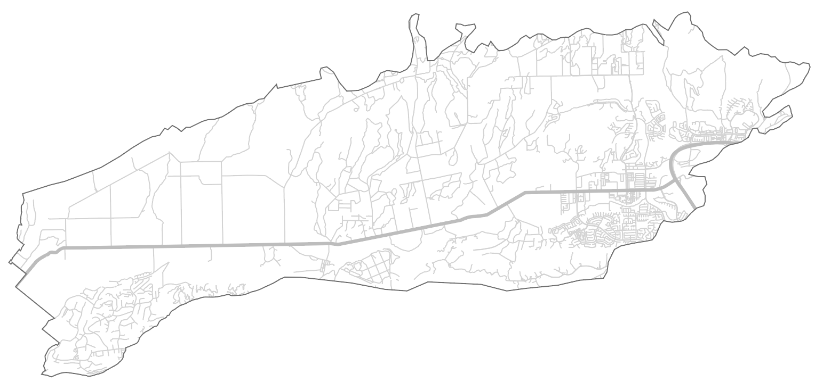
Las Posas Valley Basin Select Hydrographs
Previous GSP Modeling
34G01
19J01
Legend
Historical
Measurable
Objective
Minimum
Threshold
Projects (WLPMA)
Baseline (ELPMA)
Reduction 1
35R03
11J03
10J01
08F01

Slide 10
Modeling for the LPVB 5-Year GSP Evaluations
Update Numerical Model
Update Model Scenarios
Re-evaluate key metrics
Evaluate the numerical model’s ability to simulate current conditions
Integrate newly collected / available data to improve predictions
Incorporate new and updated project information
Update hydrology
Forecast groundwater conditions through the end of water year 2069
Directly estimate sustainable yield under different future basin management scenarios
Re-evaluate the minimum thresholds, measurable objectives, and interim milestones

Slide 11
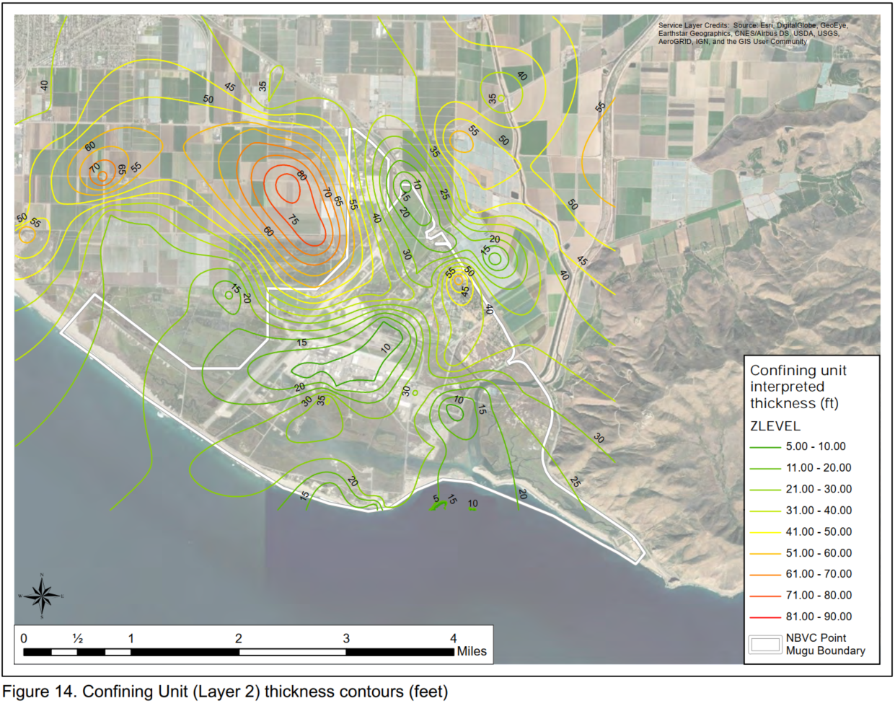
Numerical Model Update for the WLPMA Modeling for the 5-Year GSP Evaluation
Ventura Regional Groundwater Flow Model
Numerical groundwater flow model developed and maintained by United Water Conservation District
Updates since adoption of the GSP:
Expanded to encompass the Santa Paula, Filmore, and Piru Basins
Revised stratigraphic layering along the coast, near Port Hueneme and Point Mugu, based on additional geologic data
Updated coastal boundary conditions to better simulate groundwater elevations along the coastline
Numerical model extended through September 30, 2022
UWCD (2018)
UWCD (United Water Conservation District). 2021. Geologic Refinements Near Naval Base Ventura County Point Mugu, Ca. Technical Memorandum 2021-02. September 2021.

Slide 12
Numerical Model Update for the ELPMA Modeling for the 5-Year GSP Evaluation
East Las Posas Model
Numerical model provided to FCGMA by CMWD for 5-Year GSP Evaluation
Numerical model extended through September 30, 2022, to validate predictive capabilities
East Las Posas model was not revised as part of the 5-year GSP Evaluation
CMWD (Calleguas Municipal Water District). 2018. Groundwater Flow Model of the East and South Las Posas Sub-Basins. Prepared by Intera Geoscience and Engineering Solutions. January 2018.

Slide 13
Las Posas Valley Basin Select Hydrographs Through WY 2022
Legend
Measured
Simulated
34G01
19J01
11J03
35R03
08F01
10J01

Slide 14
Updating the GSP Modeling Scenarios Modeling for the 5-Year GSP Evaluation
Future Baseline
No New Projects
Projects
With EBB
Projects
Updated pumping and expanded suite of projects
Reflects recent pumping trends
Includes projects that are currently funded and under construction in the LPVB and OPV
Sustainable pumping rate
Includes projects currently funded and under construction in the LPVB and OPV
Integrates Management Actions and New Projects
Adds future projects that are consistent with the Judgment and likely to be implemented in the LPVB and OPV
Evaluates the impacts of demand reduction through voluntary temporary fallowing
Shifts the management framework
Operation of UWCDs Extraction Barrier Brackish (EBB) water project
Only applicable for WLPMA

Slide 15
Updating the GSP Modeling Scenarios: Time Period and Hydrology Modeling for the 5-Year GSP Evaluation
What was done for the GSP?
Calendar Year 2020 through Calendar Year 2069
1930 – 1979 Hydrology, adjusted by DWR’s 2070 climate change factors
What is being simulated for the 5-year evaluation?
Water Year 2023 through Water Year 2069
1933 – 1979 Hydrology, adjusted by DWR’s 2070 climate change factors
1933 replaced with 1978 to reflect the wet 2023 water year conditions
Hydrology used
for current
modeling
1933 replaced with 1978
Historical Precipitation
5-Year Evaluation
GSP (2019)

Slide 16
Baseline Model Scenario: Pumping Modeling for the 5-Year GSP Evaluation
What was done for the GSP?
Pumping held constant at average 2015-2017 rates
What is being simulated for the 5-year evaluation?
Pumping held constant at average 2016-2022 rates (37,300 AFY)
Approximately equal to the 2015-2017 rates (37,500 AFY)
Consistent with updated baseline rates for the OPV
Transitional Water Year Reporting
AFY = Acre-Feet per Year

Slide 17
Baseline Model Scenario Modeling for the 5-Year GSP Evaluation
New Baseline Projects
Project Name | Project Proponent | Basin | Anticipated Water Supply (AFY) | Projected Offset Pumping Reduction (AFY)
SVWQCP Discharges to Arroyo Las Posas | - | LPVB | 3,600 | 0
Ferro-Rose Recharge Basin | UWCD | OPV* | 2,500 | Variable
Supplemental SWP purchase | UWCD | OPV* | 6,000 | Variable
Camarillo Recycled Water Deliveries to PVCWD | City of Camarillo | OPV* | 1,300 | 1,300
Laguna road recycled water interconnect | UWCD | OPV* | 0 – 1,500 | 0
Projects simulated in the GSP:
Conejo Creek Project
North Pleasant Valley Desalter Project
AWPF Deliveries for AG
Change in projected water supply from GSP Baseline
Approximately 3,600 AFY of recharge from Arroyo Las Posas
*Included because these projects impact water levels in the WLPMA

Slide 18
Las Posas Valley Basin Select Hydrographs
19J01
34G01
5-Year Evaluation Baseline Simulated Groundwater Elevations
Groundwater elevations in 9 of the 20 key wells are forecasted to be below the minimum thresholds established in the GSP
Comparison to GSP Baseline Scenario
ELPMA groundwater elevations are up to 90 feet higher than the baseline results from the GSP
WLPMA groundwater elevations are up to 15 feet higher than the baseline results from the GSP
35R03
10J01
08F01
Legend
Measured
Measurable
Objective
5-Year
Evaluation
Minimum
Threshold
GSP (2019)
Preliminary Model Results Subject to Change

Slide 19
Baseline Model Scenario: Preliminary Results Summary Modeling for the 5-Year GSP Evaluation
Simulated Coastal Flux
Landward migration of the 2015 saline water impact front continues after 2040
50% reduction in estimated coastal flux into the UAS compared to the GSP Baseline
1,600 AFY south of Port Hueneme
5% reduction in estimated coastal flux to the LAS compared to the GSP Baseline
3,200 AFY south of Port Hueneme
Simulated Change in Storage
Groundwater in storage in the ELPMA declined at a 33% lower rate than the GSP Baseline
-2,200 AFY in the ELPMA
Groundwater elevations and storage exhibit chronic declines in northeastern ELPMA
Simulated Groundwater Elevations
Groundwater elevations remain below the minimum thresholds established in the GSP in 9 of the 20 key wells in the LPVB
Baseline conditions are not sustainable
Preliminary Model Results Subject to Change

Slide 20
No New Projects Scenario Modeling for the 5-Year GSP Evaluation
Projects, simulation period, and hydrology are consistent with the Baseline Scenario
Groundwater extractions will be incrementally adjusted until:
WLPMA
No net seawater intrusion in Oxnard
ELPMA
No net decline in groundwater in storage
Improves on previous estimate of sustainable yield through direct simulation rather than regression

Slide 21
Projects Scenario Modeling for the 5-Year GSP Evaluation
New Future Projects
Project Name | Project Proponent | Anticipated Water Supply (AFY) | Projected Offset Pumping Reduction (AFY)
ZMWC Infrastructure Improvement | ZMWC | 0 | 500
Importing of surplus water | Unknown Will be scoped, designed, and evaluated as part of the Basin Optimization Plan.
Arroyo Las Posas storm water capture and recharge
Desalter construction
Recycled water delivery pipeline
New or modified in lieu delivery infrastructure
Using CMWD facilities for replenishment
Projects and Management Actions simulated in the GSP:
Arundo Removal
In-Lieu deliveries to WLPMA
Sustainable Yield:
Iterative adjustments to simulate pumping at the sustainable yield
OPV Projects:
New projects in the OPV include the Freeman Expansion
This project will influence groundwater elevations in the WLPMA

Slide 22
Projects with EBB Scenario Modeling for the 5-Year GSP Evaluation
Project Name | Project Proponent | Anticipated Water Supply (Acre-Feet per Year) | Projected Offset Pumping Reduction
Extraction Barrier Brackish Water Project | UWCD | 5,000 | 3,500 – 5,000
EBB Design:
Extraction of 10,000 AFY near Point Mugu
5,000 AFY of treated product water
1,500 AFY delivered to Navy
3,500 AFY delivered to AG operators in the OPV
Sustainable Yield and Management Criteria
Revised method for tracking landward seawater intrusion
Revised Minimum thresholds and measurable objective
https://www.unitedwater.org/wp-content/uploads/2022/10/UWCD_WSSIII-EBB-Water-Treatment-Project-2022-10-19.pdf

Slide 23
Updating the GSP Modeling Scenarios Modeling for the 5-Year GSP Evaluation
Future Baseline
No New Projects
Projects
With EBB
Projects
Status
Preliminary Simulations Complete
Results
Projected future seawater intrusion into Oxnard
Projected future decline in groundwater in storage in the LPVB
Status
Simulations are underway
Results
Preliminary results anticipated end of April/May 2024
Status
Simulations are under development
Results
Preliminary results anticipated May 2024
Status
Simulations have not started
Results
Preliminary results anticipated June 2024

Slide 24
Stakeholder Involvement
5-Year Evaluation Timeline
May 2024 - January 2025
August 2023
Kickoff Meeting
April 2024
Public Workshops
Public Workshops
(GSP Amendments)
Submittal to
DWR
Modeling Approach Presented
to FCGMA Board
September
2023
October
2023
LPVB PAC and TAC
Consultation
Finalize Modeling
Assess Minimum Thresholds (MTs)
Assess Measurable Objectives (MOs)
Re-evaluate Sustainable Yield
Draft Reports
Plan Area and Background Review
Model Scenario Development
Current Groundwater Conditions
Monitoring Network Review
Actions Taken by FCGMA
GSP Implementation Progress
FCGMA Board Review of 5-Year Evaluations
Public Workshop

Slide 25
Questions & Answers

