Slide 1
Fox Canyon Groundwater Management Agency
5-Year GSP Evaluation for the OPV: Numerical Modeling and Projects
Jill Weinberger and Trevor jones
April 2024

Slide 2
Table of Contents
01
5-Year Evaluation Timeline
02
Previous GSP Modeling
03
Modeling for the 5-Year Evaluation
04
Opportunities for Engagement

Slide 3
Stakeholder Involvement
5-Year Evaluation Timeline
May 2024 - January 2025
August 2023
Kickoff Meeting
April 2024
Public Workshop
Public Workshop
(GSP Amendments)
Submittal to
DWR
Modeling Approach Presented
to FCGMA Board
September
2023
October
2023
Finalize Modeling
Assess Minimum Thresholds (MTs)
Assess Measurable Objectives (MOs)
Re-evaluate Sustainable Yield
Draft Reports
Plan Area and Background Review
Model Scenario Development
Current Groundwater Conditions
Monitoring Network Review
Actions Taken by FCGMA
GSP Implementation Progress
FCGMA Board Review of 5-Year Evaluations
Public Workshop

Slide 4
Stakeholder Involvement
5-Year Evaluation Timeline
May 2024 - January 2025
August 2023
Kickoff Meeting
April 2024
Public Workshop
Public Workshop
(GSP Amendments)
Submittal to
DWR
Modeling Approach Presented
to FCGMA Board
September
2023
October
2023
Finalize Modeling
Assess Minimum Thresholds (MTs)
Assess Measurable Objectives (MOs)
Re-evaluate Sustainable Yield
Draft Reports
Plan Area and Background Review
Model Scenario Development
Current Groundwater Conditions
Monitoring Network Review
Actions Taken by FCGMA
GSP Implementation Progress
FCGMA Board Review of 5-Year Evaluations
Public Workshop

Slide 5
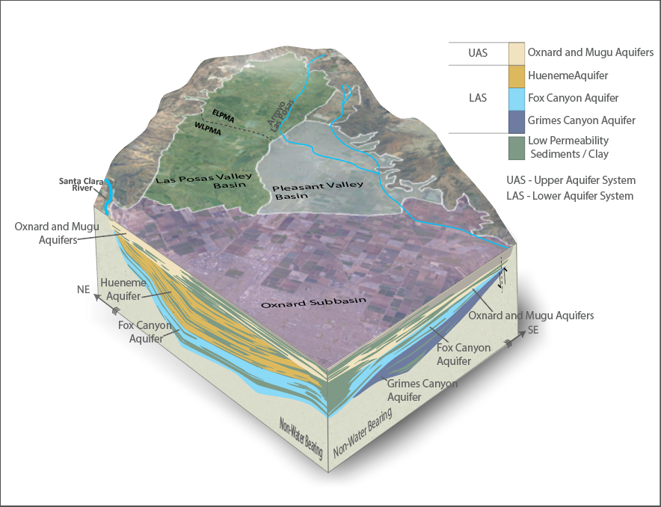
Background Information – Undesirable Results in the OPV Previous GSP Modeling
Sustainability Indicators
Groundwater Elevation
Groundwater in Storage
Seawater Intrusion
Groundwater Quality
Land Subsidence
Interconnected Surface Water
and Groundwater

Slide 6
Background Information - GSP Modeling Previous GSP Modeling
Ventura Regional Groundwater Flow Model
Numerical groundwater flow model developed and maintained by United Water Conservation District (UWCD 2018)
Calibrated to groundwater elevations measured between 1985 and 2015
Used to characterize groundwater budgets, forecast future groundwater conditions, and estimate the sustainable yield
Independent peer reviews characterized model uncertainty and appropriate use for the GSP
UWCD (United Water Conservation District). 2018. Ventura Regional Groundwater Flow Model and Updated Hydrogeologic Conceptual Model: Oxnard Plain, Oxnard Forebay, Pleasant Valley, West Las Posas, and Mound Groundwater Basins. Open-File Report 2018-02. July 2018.

Slide 7
Background Information – GSP Modeling Previous GSP Modeling
GSP Modeling Scenarios
Model Scenario | Groundwater Extractions (Acre-Feet)
 | Oxnard Subbasin | Pleasant Valley Basin | Total
Future Baseline | 68,000 | 14,000 | 82,000
Future Baseline With Projects | 66,000 | 12,000 | 78,000
Reduction With Projects | 40,000 | 10,000 | 50,000
Reduction Without Projects 1 | 39,000 | 8,000 | 47,000
Reduction Without Projects 2 | 30,000 | 10,000 | 40,000
Reduction Without Projects 3 | 30,000 | 14,000 | 44,000
Sustainable Yield Estimates:
Oxnard Subbasin =$\left\{\begin{aligned}UAS=32,000 ±6,000 AFY \\ LAS=4,000 ±2,300 AFY\end{aligned}\right.$
Pleasant Valley Basin=$\left\{\begin{aligned}Older Alluvium=4,400 ±500 AFY \\ LAS=7,200 ±700 AFY\end{aligned}\right.$
AFY = Acre-Feet per Year

Slide 8
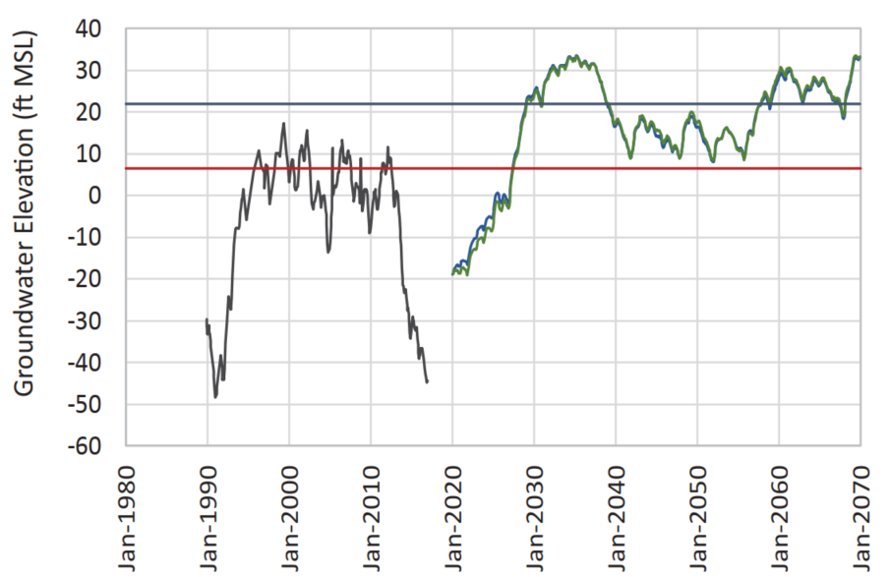
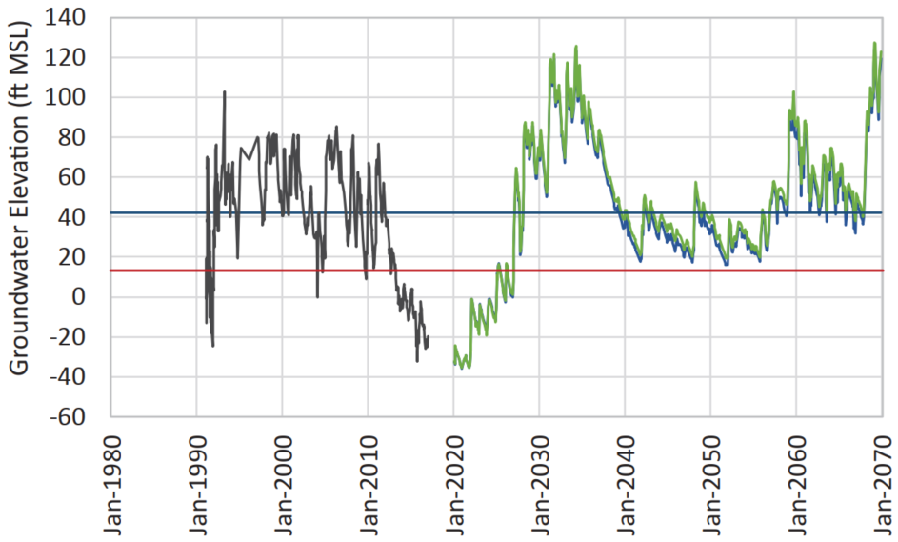
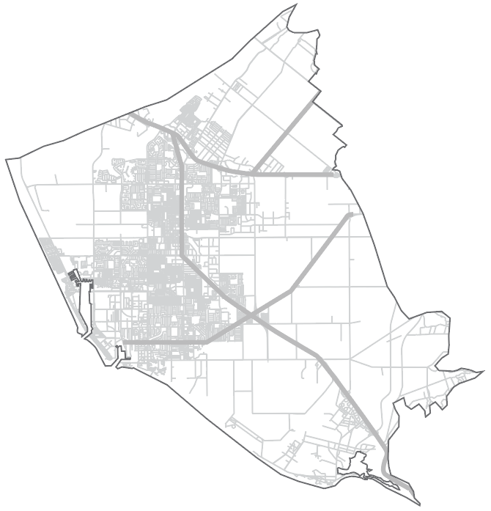
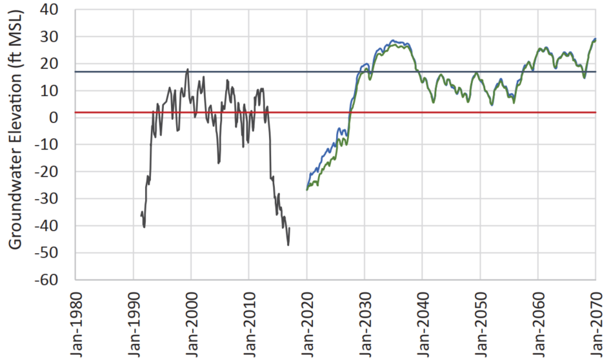
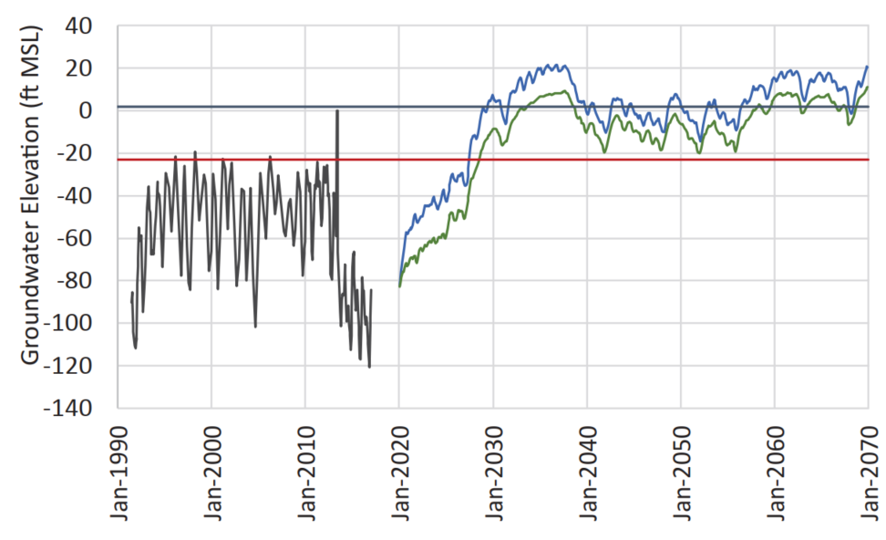
Background Information - GSP Modeling Previous GSP Modeling
07L04
01C02
Legend
Historical
Measurable
Objective
Minimum
Threshold
Baseline
32Q04
20J04
Reduction 1

Slide 9
Modeling for the OPV 5-Year GSP Evaluations
Update Numerical Model
Update Model Scenarios
Re-evaluate key metrics
Evaluate the numerical model’s ability to simulate current conditions
Integrate newly collected / available data to improve predictions
Incorporate new and updated project information
Update hydrology
Forecast groundwater conditions through the end of water year 2069
Directly estimate sustainable yield under different future basin management scenarios
Re-evaluate the minimum thresholds, measurable objectives, and interim milestones

Slide 10
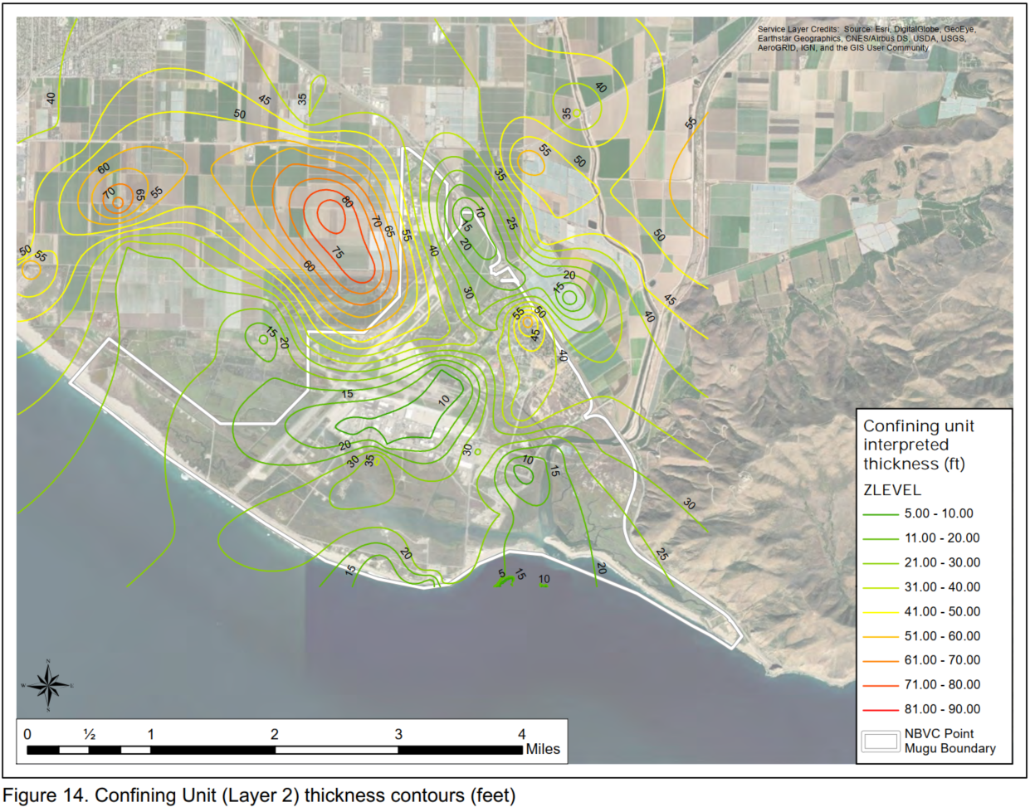
Numerical Model Update Modeling for the 5-Year GSP Evaluation
Ventura Regional Groundwater Flow Model
Numerical groundwater flow model developed and maintained by United Water Conservation District
Updates since adoption of the GSP:
Expanded to encompass the Santa Paula, Filmore, and Piru Basins
Revised stratigraphic layering along the coast, near Port Hueneme and Point Mugu, based on additional geologic data
Updated coastal boundary conditions to better simulate groundwater elevations along the coastline
Extended to simulate groundwater conditions through water year 2022
UWCD (2018)
UWCD (United Water Conservation District). 2021. Geologic Refinements Near Naval Base Ventura County Point Mugu, Ca. Technical Memorandum 2021-02. September 2021.

Slide 11
Oxnard Subbasin Select Hydrographs Through WY 2022
Modeling for the 5-Year GSP Evaluation
07L04
01C02
32Q04
20J04
Legend
Measured
Simulated

Slide 12
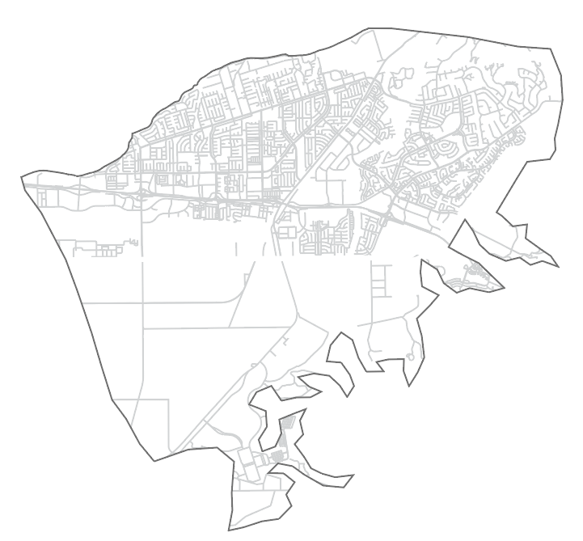
Pleasant Valley Basin Select Hydrographs Through WY 2022
Modeling for the 5-Year GSP Evaluation
19M05
Legend
Measured
Simulated
03C01
34G02
04K01

Slide 13
Updating the GSP Modeling Scenarios Modeling for the 5-Year GSP Evaluation
Future Baseline
No New Projects
Projects
With EBB
Projects
Updated pumping and expanded suite of projects
Reflects recent pumping trends
Includes projects that are currently funded and under construction in the OPV
Sustainable pumping rate
Includes projects currently funded and under construction in the OPV
Integrates Management Actions and New Projects
Adds future projects that are likely to be implemented
Evaluates the impacts of demand reduction through voluntary temporary fallowing
Shifts the management framework
Operation of UWCDs Extraction Barrier Brackish (EBB) water project

Slide 14
Updating the GSP Modeling Scenarios: Time Period and Hydrology Modeling for the 5-Year GSP Evaluation
What was done for the GSP?
Calendar Year 2020 through Calendar Year 2069
1930 – 1979 Hydrology, adjusted by DWR’s 2070 climate change factors
What is being simulated for the 5-year evaluation?
Water Year 2023 through Water Year 2069
1933 – 1979 Hydrology, adjusted by DWR’s 2070 climate change factors
1933 replaced with 1978 to reflect the wet 2023 water year conditions
Historical Precipitation
5-Year GSP
GSP (2019)

Slide 15
Baseline Model Scenario: Pumping in the Oxnard Subbasin Modeling for the 5-Year GSP Evaluation
What was done for the GSP?
Pumping held constant at average 2015-2017 rates
What is being simulated for the 5-year evaluation?
Pumping held constant at average 2016-2022 rates
Reflects ~5% reduction in pumping compared to 2015-2017 period
Similar to total Oxnard Subbasin allocation
What is the same between the GSP and 5-Year evaluation?
Monthly pumping adjusted based on projected surface water, recycled water, and imported water availability
Transitional Water Year Reporting

Slide 16
Baseline Model Scenario: Pumping in the Pleasant Valley Basin Modeling for the 5-Year GSP Evaluation
What was done for the GSP?
Pumping held constant at average 2015-2017 rates
What is being simulated for the 5-year evaluation?
Pumping held constant at average 2016-2022 rates
Reflects ~15% reduction in pumping compared to 2015-2017 period
Similar to total Pleasant Valley Basin allocation
What is the same between the GSP and 5-Year evaluation?
Monthly pumping adjusted based on projected surface water, recycled water, and imported water availability
Transitional Water Year Reporting

Slide 17
Baseline Model Scenario Modeling for the 5-Year GSP Evaluation
New Baseline Projects
Project Name | Project Proponent | Anticipated Water Supply (AFY) | Projected Offset Pumping Reduction (AFY)
Ferro-Rose Recharge Basin | UWCD | 2,500 | Variable
Supplemental State Water Project water purchase | UWCD | 6,000 | Variable
Camarillo Recycled Water Deliveries to PVCWD | City of Camarillo | 1,300 | 1,300
Laguna road recycled water interconnect | UWCD | 0 – 1,500 | 0
Projects simulated in the GSP:
Conejo Creek Project
North Pleasant Valley Desalter Project
AWPF Deliveries for AG
Total increase in projected water supply
New projects increase total water supply in the OPV up to an average of approximately 6,800 AFY

Slide 18
Oxnard Subbasin Select Hydrographs
Modeling for the 5-Year GSP Evaluation
07L04
01C02
Comparison to GSP Baseline Scenario
Simulated groundwater elevations in the Fox Canyon aquifer are 5 to 25 feet higher than the baseline results from the GSP
32Q04
Legend
Measured
Measurable
Objective
20J04
5-Year
Evaluation
Minimum
Threshold
GSP (2019)
Preliminary Model Results
Subject to Change

Slide 19
Pleasant Valley Select Hydrographs
Modeling for the 5-Year GSP Evaluation
19M05
Comparison to GSP Baseline Scenario
Simulated groundwater elevations in the Fox Canyon aquifer are approximately 30 feet higher than the baseline results from the GSP, except for the far northern part of the PVB
03C01
Legend
34G02
Measured
Measurable
Objective
04K01
5-Year
Evaluation
Minimum
Threshold
GSP (2019)
Preliminary Model Results Subject to Change

Slide 20
Baseline Model Scenario: Preliminary Results Modeling for the 5-Year GSP Evaluation
Simulated Coastal Flux
1,600 AFY into the Saline Intrusion Management Area in the UAS
3,200 AFY into the Saline Intrusion Management Area in the LAS
Comparison to GSP Baseline Scenario
50% reduction in estimated coastal flux into the UAS
5% reduction in estimated coastal flux to the LAS
Preliminary Model Results Subject to Change

Slide 21
Baseline Model Scenario: Preliminary Results Modeling for the 5-Year GSP Evaluation
Summary of Baseline Results
Landward migration of the 2015 saline water impact front after 2040 is an undesirable result for the Oxnard Subbasin
Estimated Landward Coastal Flux (Seawater Intrusion, 2040-2070):
Approximately 1,600 AFY in the UAS
Approximately 3,200 AFY in the LAS
Projected future groundwater elevations are below the minimum threshold elevation in 20 of the 34 Key Wells in the OPV
While groundwater elevations are higher than the 2019 GSP modeling, preliminary results indicate that Baseline conditions are not sustainable
Preliminary Model Results Subject to Change

Slide 22
No New Projects Scenario Modeling for the 5-Year GSP Evaluation
Projects, simulation period, and hydrology are consistent with the Baseline Scenario
Groundwater extractions will be incrementally adjusted until average annual flux into the Saline Intrusion Management Area is zero
Improves on previous estimate of sustainable yield through direct simulation rather than regression
Sustainable Yield
32,000 AFY

Slide 23
Projects Scenario Modeling for the 5-Year GSP Evaluation
New Future Projects
Project Name | Project Proponent | Anticipated Water Supply (AFY) | Projected Offset Pumping Reduction (AFY)
Freeman Expansion | UWCD | 10,000 | Variable
AWPF Phase II Expansion | City of Oxnard | 7,500 – 15,000 | Unknown
Recycled Water Pipeline | PVCWD | Unknown* | Unknown
City of Oxnard ASR Project | City of Oxnard | Unknown* | Unknown
City of Oxnard Injection Barrier Project | City of Oxnard | Unknown* | Unknown
Projects and Management Actions in the GSP:
Voluntary Temporary Fallowing
North Pleasant Valley Desalter Project
Sustainable Yield:
Iterative adjustments to simulate pumping at the sustainable yield
*Depends on AWPF Operations

Slide 24
Projects with EBB Scenario Modeling for the 5-Year GSP Evaluation
Project Name | Project Proponent | Anticipated Water Supply (Acre-Feet per Year) | Projected Offset Pumping Reduction
Extraction Barrier Brackish Water Project | UWCD | 5,000 | 3,500 - 5,000
EBB Design:
Extraction of 10,000 AFY near Point Mugu
5,000 AFY of treated product water
1,500 AFY delivered to Navy
3,500 AFY delivered to AG operators in the OPV
Sustainable Yield and Management Criteria
Revised method for tracking landward seawater intrusion
Revised Minimum thresholds and measurable objective
https://www.unitedwater.org/wp-content/uploads/2022/10/UWCD_WSSIII-EBB-Water-Treatment-Project-2022-10-19.pdf

Slide 25
Updating the GSP Modeling Scenarios Modeling for the 5-Year GSP Evaluation
Future Baseline
No New Projects
Projects
With EBB
Projects
Status
Preliminary Results Complete
Results
Projected future seawater intrusion into Oxnard
Status
Simulations are underway
Results
Preliminary results anticipated end of April/May 2024
Status
Simulations are under development
Results
Preliminary results anticipated May 2024
Status
Simulations have not started
Results
Preliminary results anticipated June 2024

Slide 26
Stakeholder Involvement
5-Year Evaluation Timeline
May 2024 - January 2025
August 2023
Kickoff Meeting
April 2024
Public Workshop
Public Workshop
(GSP Amendments)
Submittal to
DWR
Modeling Approach Presented
to FCGMA Board
September
2023
October
2023
Finalize Modeling
Assess Minimum Thresholds (MTs)
Assess Measurable Objectives (MOs)
Re-evaluate Sustainable Yield
Draft Reports
Plan Area and Background Review
Model Scenario Development
Current Groundwater Conditions
Monitoring Network Review
Actions Taken by FCGMA
GSP Implementation Progress
FCGMA Board Review of 5-Year Evaluations
Public Workshop

Slide 27
Questions & Answers

